Slide 1
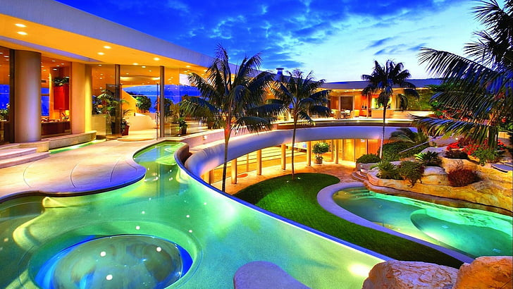


LDRP
Institute Of Technology & Research Gandhinagar
Hotel Scrapper

Slide 2
Topics We Want to Discuss
Objectives Introduction Requirements Authorization
Features of Users
Diagrams
Conclusion

Slide 3
Objectives
Make easy accessible and usable Easy to do analysis and comparision
Save time and Improve efficiency
Gives specific requirement data
Ensure reliability of scraping data

Slide 4
Introduction
Our project will about data retrival and extraction system designed to collect information from various hotel websites and consolidate it into a structured format.
By this project users will be saving their time and will not get any
error or inconsistency for finding any hotel at any location.
This project will get you the automation solution for relevant
information such as hotel name, price and availability.

Slide 5
Requirement
Functional Requirements
Non Functional Requirements

Slide 6
Functional Requirements
FUNCTIONALITIES OF ADMIN
Admin plays a main role in this project. Admin have right to do authorization of user. Create or Update or delete hotels database

Slide 7
Functional Requirements
FUNCTIONALITIES OF USER
Once user enter valid email id and password after registration he/she can see following information
Viewing data of hotels

Slide 8
Non Functional Requirements
Hardware Requirements Software Requirements

Slide 9
Hardware Requirements
Processor : Standard processor with speed of 1.6 GHz or more
RAM : 64 MB RAM or more
Hard Disk : 512 GB or more
Monitor : Standard color monitor
Keyboard : Standard Keyboard
Mouse : Standard mouse

Slide 10
Software Requirements
Programming Languages Uses : HTML , CSS, JavaScript,Python Development Tools : React js , Django
Data base : MySQL, MongoDB
Localhost Server : Xampp
Application Software : MS word, Canva
Operating System : Windows 10
Web Browser : Chrome
Web Tool : Draw io

Slide 11
Authorizations
We may assign a user some particular authorizations on parts of database
Authorization to view data
Admin can access four informative part of the database
(view data, insert data, update data , delete data )

Slide 12
Users of System
Admin User

Slide 13
Features of Users
A super user (Admin) who enjoys all facilities Add , Update, delete, display data
Normal user can create account and view data

Slide 14
Diagrams
Use case diagram ER Diagram
Class Diagram Activity Diagram
Sequence Diagram
DFD Diagram

Slide 15
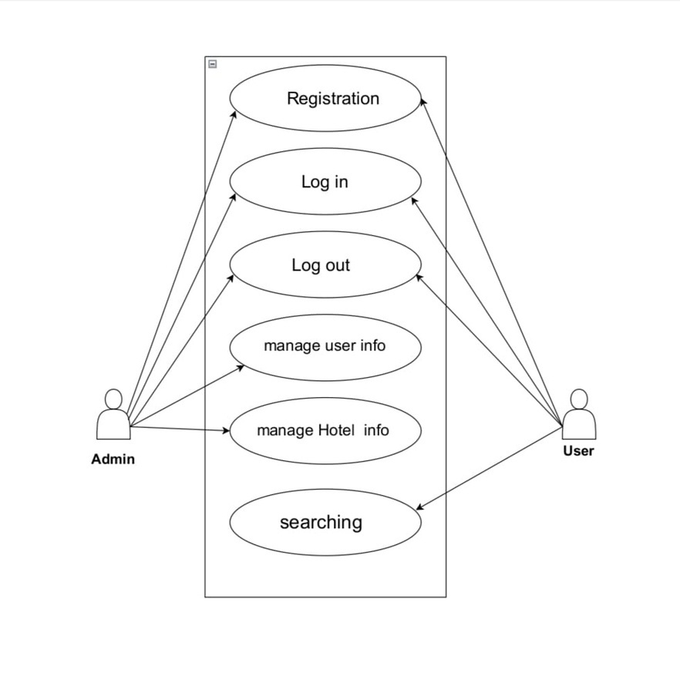
Use Case Diagram

Slide 16
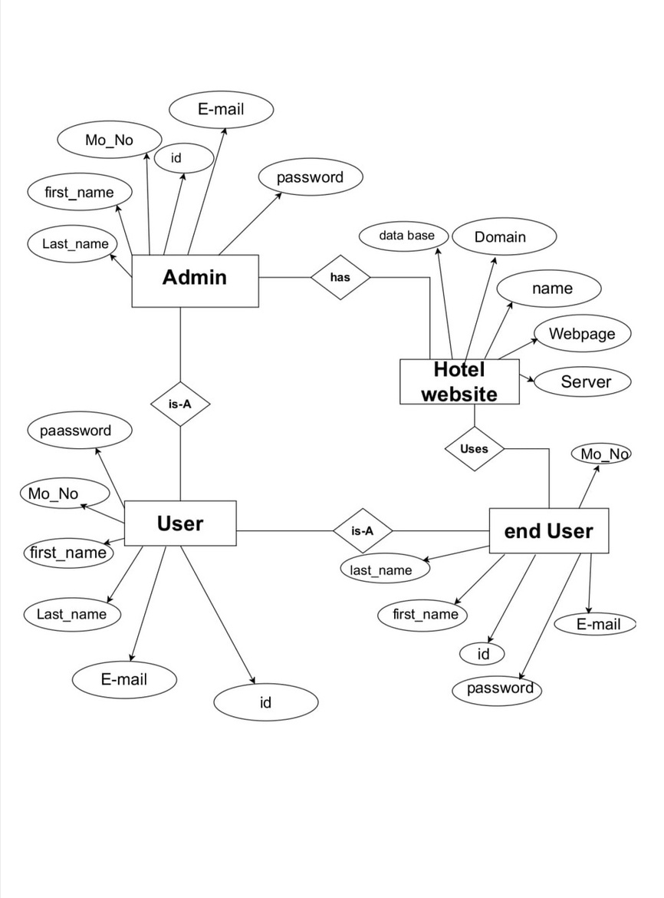
ER Diagram

Slide 17
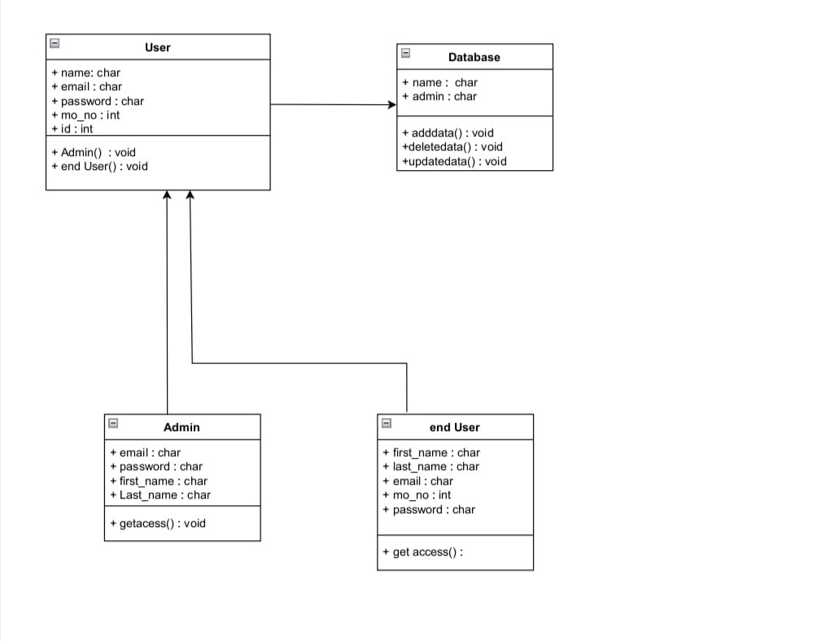
Class Diagram

Slide 18
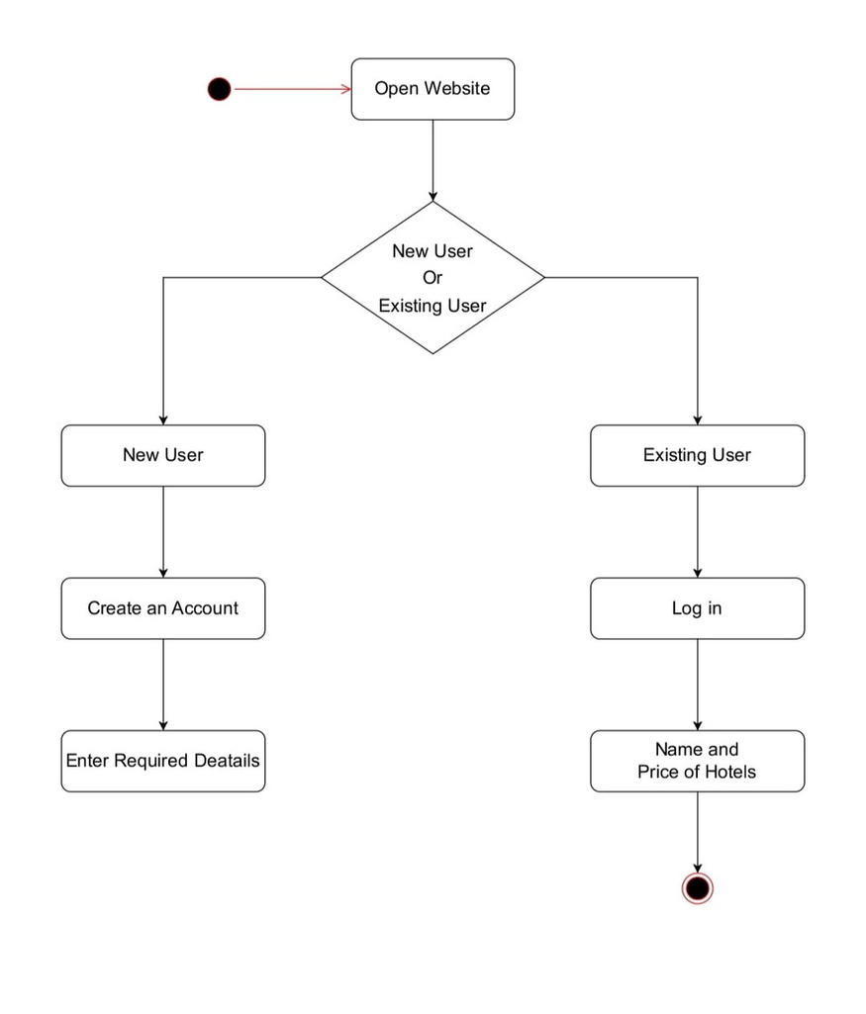
Activity Diagram

Slide 19
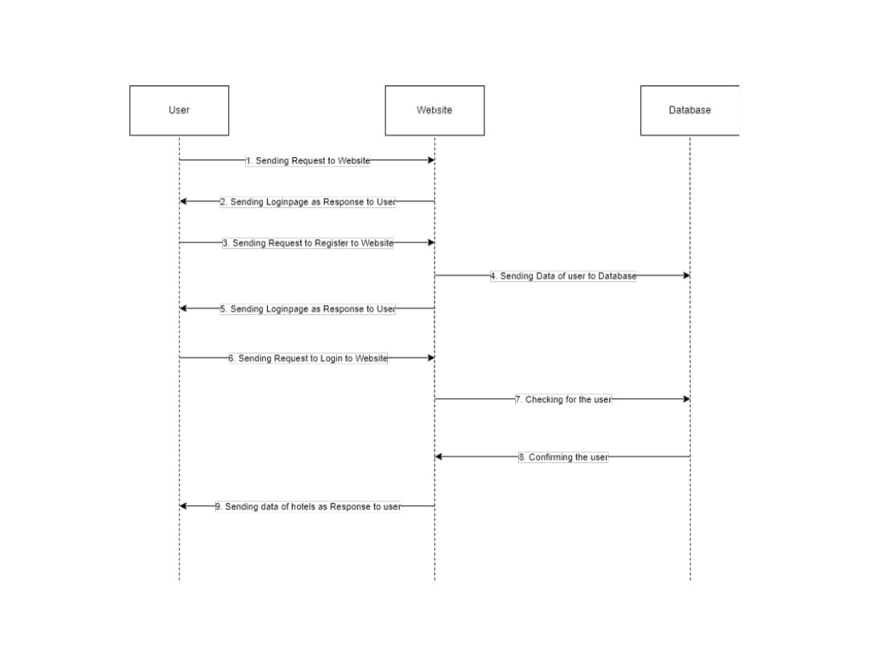
Sequence Diagram

Slide 20
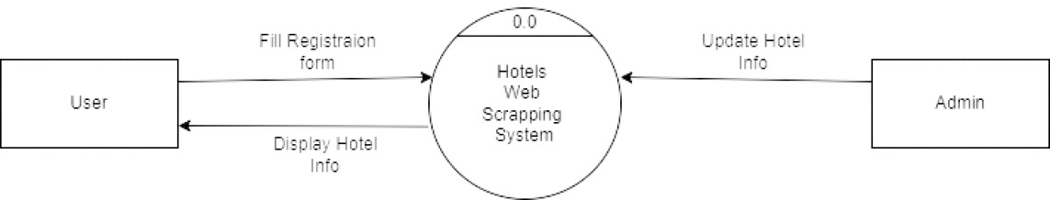
DFD (Level - 0)

Slide 21
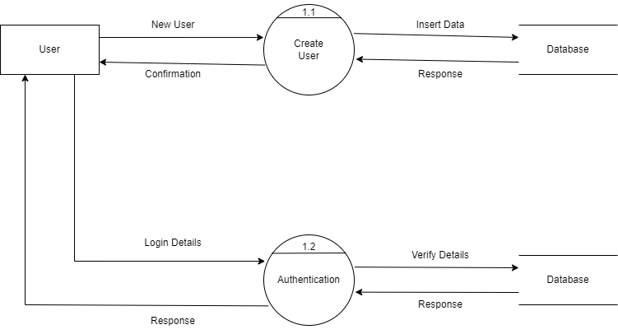
DFD (Level - 1)

Slide 22
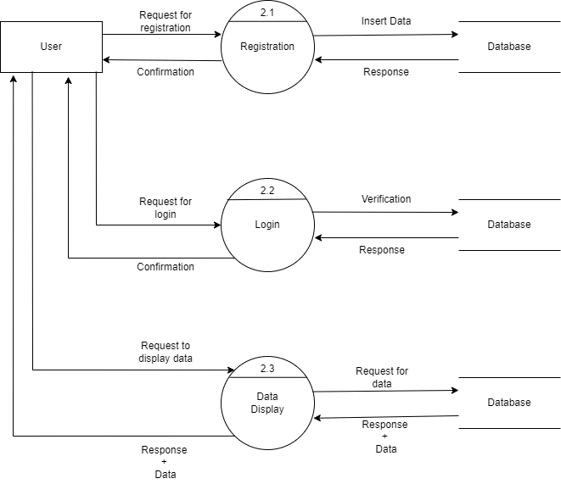
DFD (Level - 2)

Slide 23
Functionalities
Website Home page
User Registration page Website Hotel data page Admin Dashboard

Slide 24
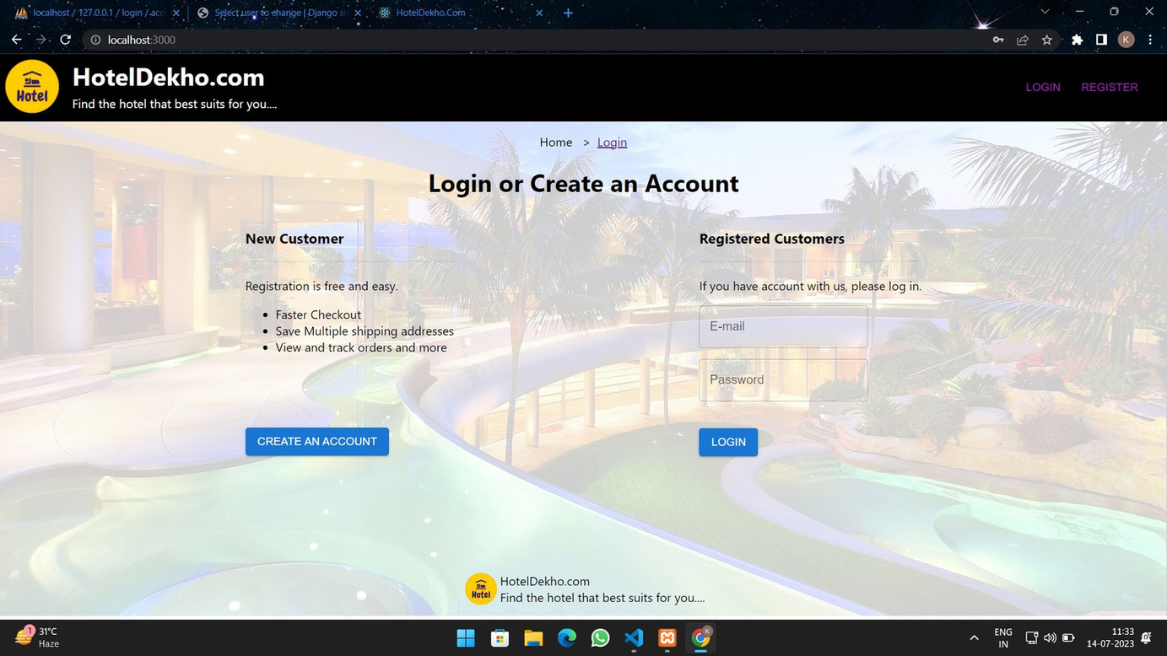
Website Home Page :

Slide 25
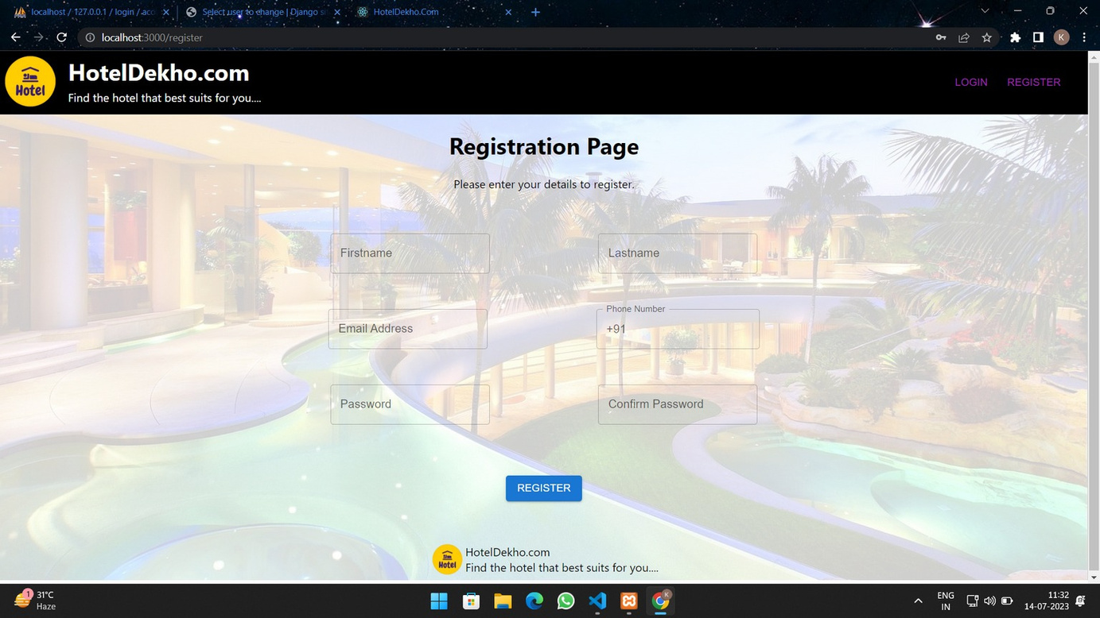
User Registration Page :

Slide 26
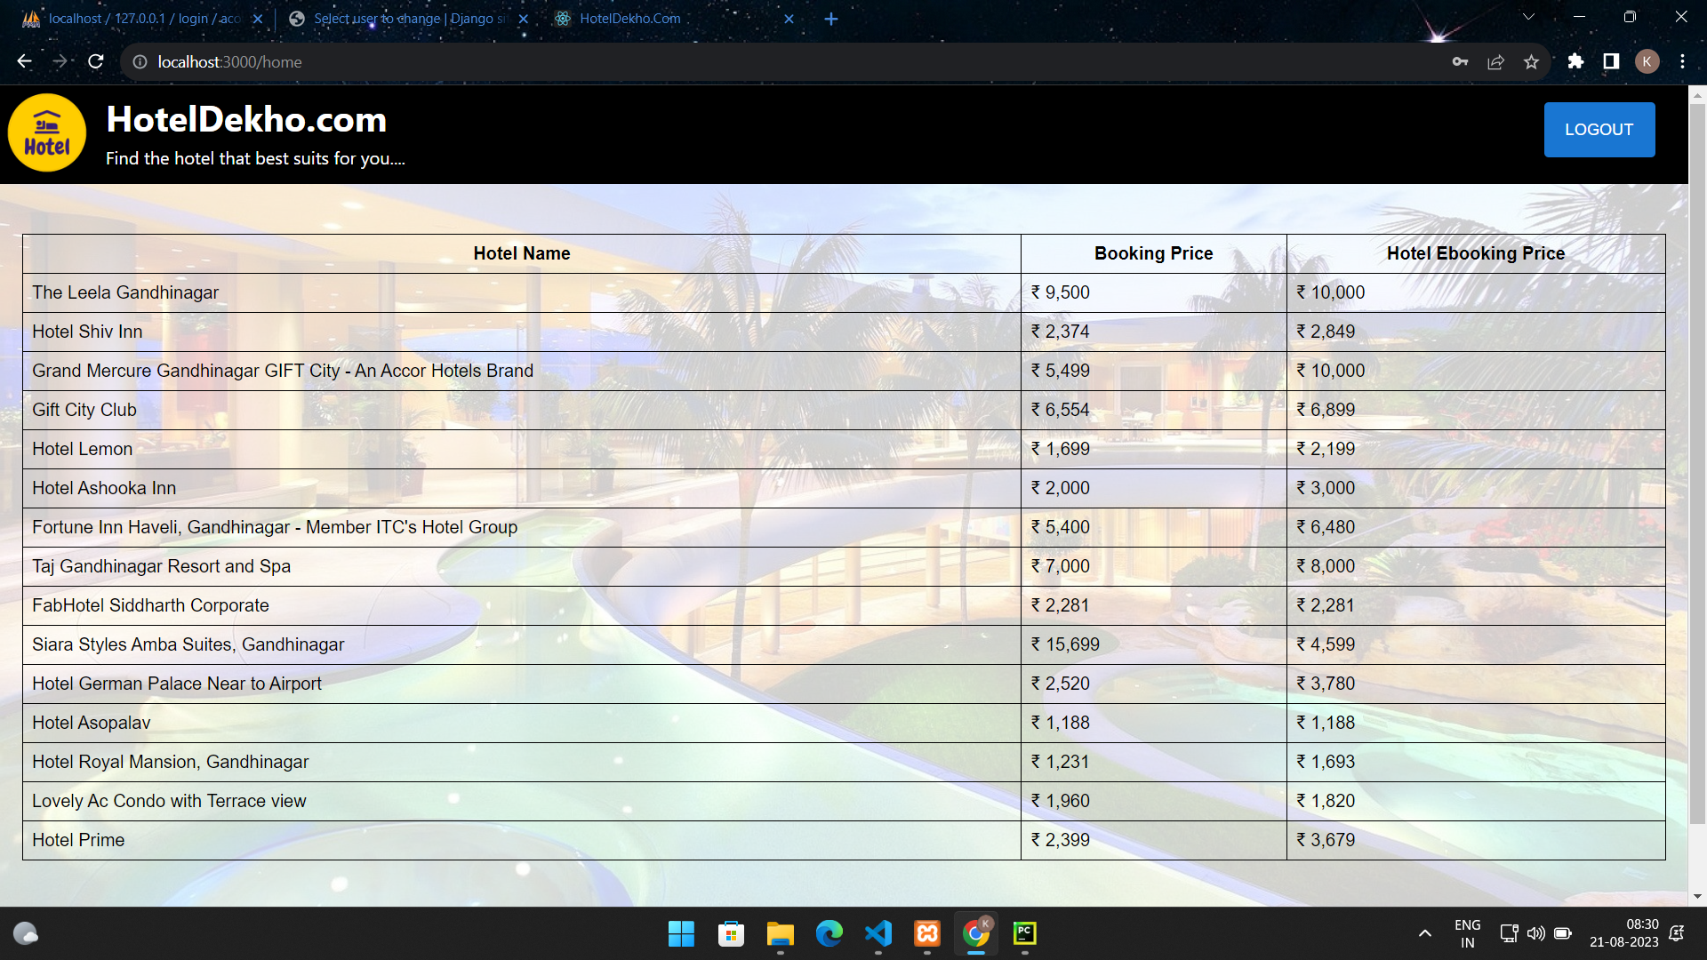
Website Hotel data Page :

Slide 27
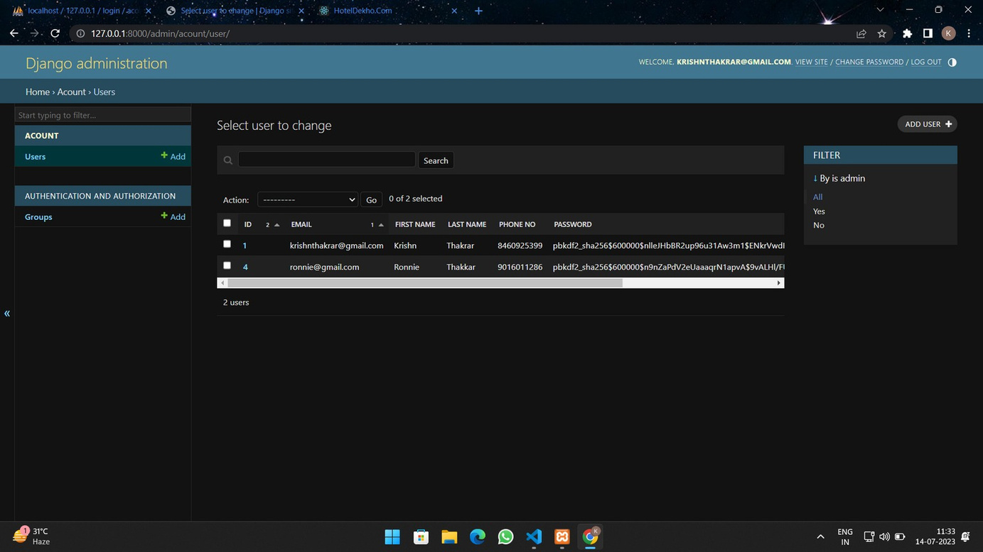
Admin Dashboard :

Slide 28
Conclusion
So here we can conclude that we display the data of comparision of hotel prices to find best suitable hotel according to your requirement.

